Slide 1

Filing Status
4491-04 Filing Status v11.0 VO.pptx
Form 1040 Lines 1-3
Pub 4012 Tab B
Pub 17 Chapter 2
Notes:
1

Slide 2
Overview
Filing statuses
  Single
  Married Filing Joint
  Married Filing Separate
  Head Of Household
  Qualifying Widow/er
Filing status affects tax rate, and eligibility for certain credits

Slide 3
Objectives
Know requirements for the five statuses
  Single
  Married Filing Joint
  Married Filing Separate
  Head Of Household
  Qualifying Widow/er
Define and compare the filing statuses
Select the correct filing status
Federal and State filing statuses are usually the same
  May vary if NJ “Civil Union” applies (Can file using Married/Civil Union status in NJ; Cannot use Married for Federal)
  Note: NJ Registered “Domestic Partner” is legally different from “Civil Union” - cannot use Married/Civil Union status
  Status must be same if using TaxWise
Notes:
3

Slide 4
Analysis Of Living Situation Is Critical
Marital status as of December 31st for tax purposes
Who was living in the home during the year?
Their relationship/dependency
Who paid more than half the cost of keeping up the home?
If widow(er) with dependent child – date of spouse death
Notes:
4

Slide 5
Single
Not married on December 31st
If widowed in either of the 2 prior years with qualifying dependent, and not remarried, select Qualifying Widow/er
If widowed in tax year, select MFJ
If maintained home for child or dependent relative, select Head of Household (HOH)
Notes:
5

Slide 6
Married Filing Joint (MFJ) – (Lowest Tax Rate)
If married on December 31st, considered married for entire year
Common law marriage if recognized in the state where it began
Spouse died during year and TP did not remarry
Notes:
6

Slide 7
Married Filing Separate (MFS) – Highest Tax Rate
Taxpayer chooses to file MFS
Show spouse name/SSN on return
If TP itemizes, spouse must also itemize
If taxpayer didn’t live with spouse last 6 months but provided home for dependent child, select HOH vs MFS
Notes:
7

Slide 8
Married Filing Separate – Disadvantages
Highest tax rate/lower standard deduction
Cannot claim EIC or Child Tax Credit (CTC)
Cannot take Child Dependent Care (CDC) credit
Cannot take education credits or tuition and fees deduction
Cannot deduct student loan interest
Capital loss limited to $1,500 (not $3,000)
Notes:
8

Slide 9
MFS - Lived With Spouse Anytime During Year
Must include all social security benefits as taxable income
Cannot claim credit for the elderly or the disabled
Cannot roll over Traditional IRA to Roth IRA
Notes:
9

Slide 10
Head Of Household (HOH)
Unmarried or Legally Separated
Paid over 50% of cost for maintaining home that was main home for over 6 months for
  Qualifying Child Dependent – Exception: Non custodial parent rule
  Qualifying Relative Dependent (and providing >50% of support – Multiple Support Agreement not sufficient by itself)
Paid over 50% cost for parents living elsewhere
Refer to Pub 4012 Tab B
Note: Definitions of Qualifying Child and Qualifying Relative in Exemptions presentation
Notes:
10

Slide 11
Head Of Household
If Married (Pub 4012 Tab B)
File separately from spouse
Lived apart last 6 months
Provided over 50% cost of maintaining home
Was main home for your child, adopted child, stepchild, or eligible foster child for over 6 months
No other relatives qualify to claim exemption
Notes:
11

Slide 12
Special Notes
Child is considered to have lived with you all year if born or died during year
An unrelated person who is your qualifying relative for tax purposes, only because he or she lived with you does not qualify you for HOH filing status
Notes:
12

Slide 13
Qualifying Widow/Widower (QW)
Spouse died in one of past two years
Has child who qualifies as dependent
Provided over 50% of the cost of maintaining a home which was child’s main home for the entire year
Can file QW for 2 yrs, then HOH or single
NOTE: Entitled to MFJ year spouse died
Notes:
13

Slide 14
Filing Status Determination
(See Pub 4012 – Tab B)
Go To Page B-1 in Pub 4012
Notes:
14

Slide 15
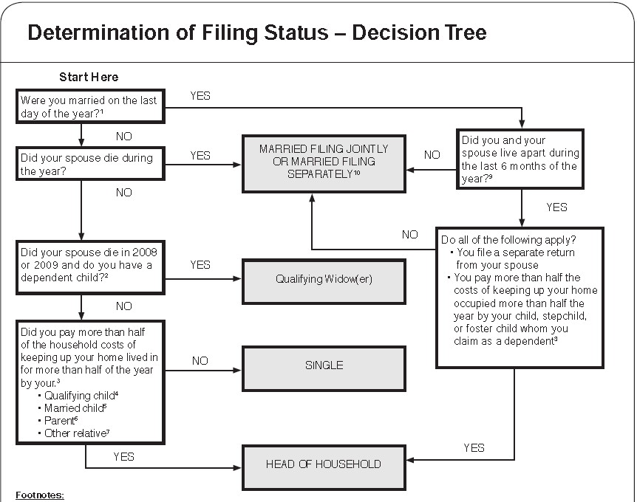
Filing Status Determination
(See Pub 4012 – Tab B)
Notes:
15

Slide 16
FILING STATUS QUIZ #1
Tab B
Mrs. Doe is divorced
Pays >50% cost of the home she shares with her 20-year-old daughter, Emily
Emily is single, works part time, and earned $4000 that she spent on herself. She is not a student
Can Mrs. Doe file as Head of Household?

Slide 17
FILING STATUS QUIZ #1
ANSWERS
NO
  Not a Qualifying Child
    >18 years of age
    Not a student
  Not a Qualifying Relative Dependent
    Income >$3,700

Slide 18
FILING STATUS QUIZ #2
Mr. Buck provides total support for his two children.
His wife died in 2009, and he has not remarried.
What is the best filing status for Mr. Buck?

Slide 19
FILING STATUS QUIZ #2
ANSWERS
HEAD OF HOUSEHOLD
What would have been best in TY2010?
QUALIFYING WIDOWER

Slide 20
FILING STATUS QUIZ #3
Jane, 69, whose husband died July 1, had a $20,000 pension and $15,000 in social security in the tax year.
Her 10-year-old grandson lived with her and is her dependent.
What is the best filing status for Jane?

Slide 21
FILING STATUS QUIZ #3
ANSWERS
MARRIED FILING JOINT
Assuming nothing changes, what filing status is best for the next 3 tax years?
  QUALIFYING WIDOWER – next two
  HEAD OF HOUSEHOLD – third year

Slide 22
FILING STATUS QUIZ #4
Luke and Linda are still married, but chose to live apart for most of the year
Their two children lived with Linda all year
In July, Luke was out of a job so he moved back in the house for just that month
What filing status can they each choose?
MFJ or MFS (both must use same status)

Slide 23
FILING STATUS QUIZ #5
Dick and Jane are married, lived apart all year, and are filing separate returns.
Their 25-year-old daughter Jody lived with Jane all year while attending school full-time.
Jody earned $2500 during the summer.
What is Jane’s best filing status?
  HEAD OF HOUSEHOLD

Slide 24
FILING STATUS QUIZ #5
ANSWER
What would Jane’s filing status be if Jody earned $3800?
  MARRIED FILING SEPARATELY

Slide 25
FILING STATUS QUIZ #6
Sarah, age 62, has a 40 year old son living with her.
He earned $40,000 and put all of it in the bank.
Can Sarah claim Head of Household?

Slide 26
FILING STATUS QUIZ #6 ANSWER
NO - son must be either a Qualifying Child or a Qualifying Relative
  Not a Qualifying Child: age
  Not a Qualifying Relative: income >$3,700

